Slide 1

CSC 533: Privacy in Digital Age (Fall 2020) Lecture 2: De-anonymization attacks
Anupam Das
Aug 13, 2020

Slide 2
Topic: Data Privacy
Goals for today’s class:
Review well-known incidences of data de-anonymization
Grasp why such de-anonymization was possible
Some contents are borrowed from online material provided by Vitaly Shmatikov.

Slide 3
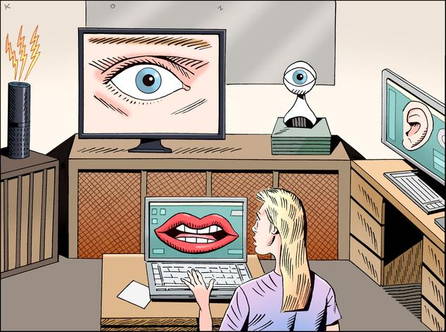
You are being watched!
Data about our life styles and habits are out there

Slide 4

Taste and purchases
Notes:
preserving privacy has become hard in our modern society due ….

Slide 5

Social Networks

Slide 6
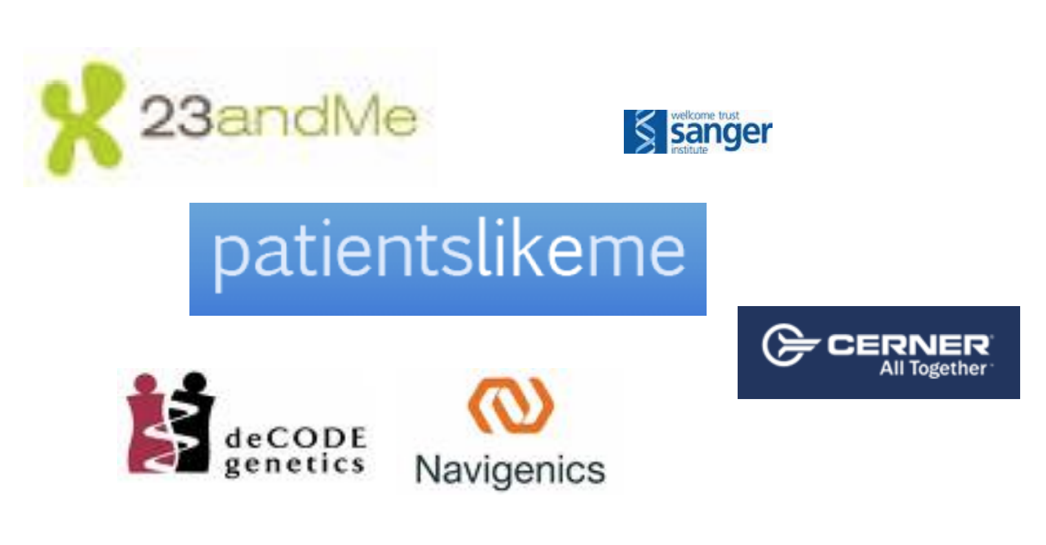
Health care and genetics

Slide 7

Web tracking

Slide 8

Online-Offline aggregation

Slide 9
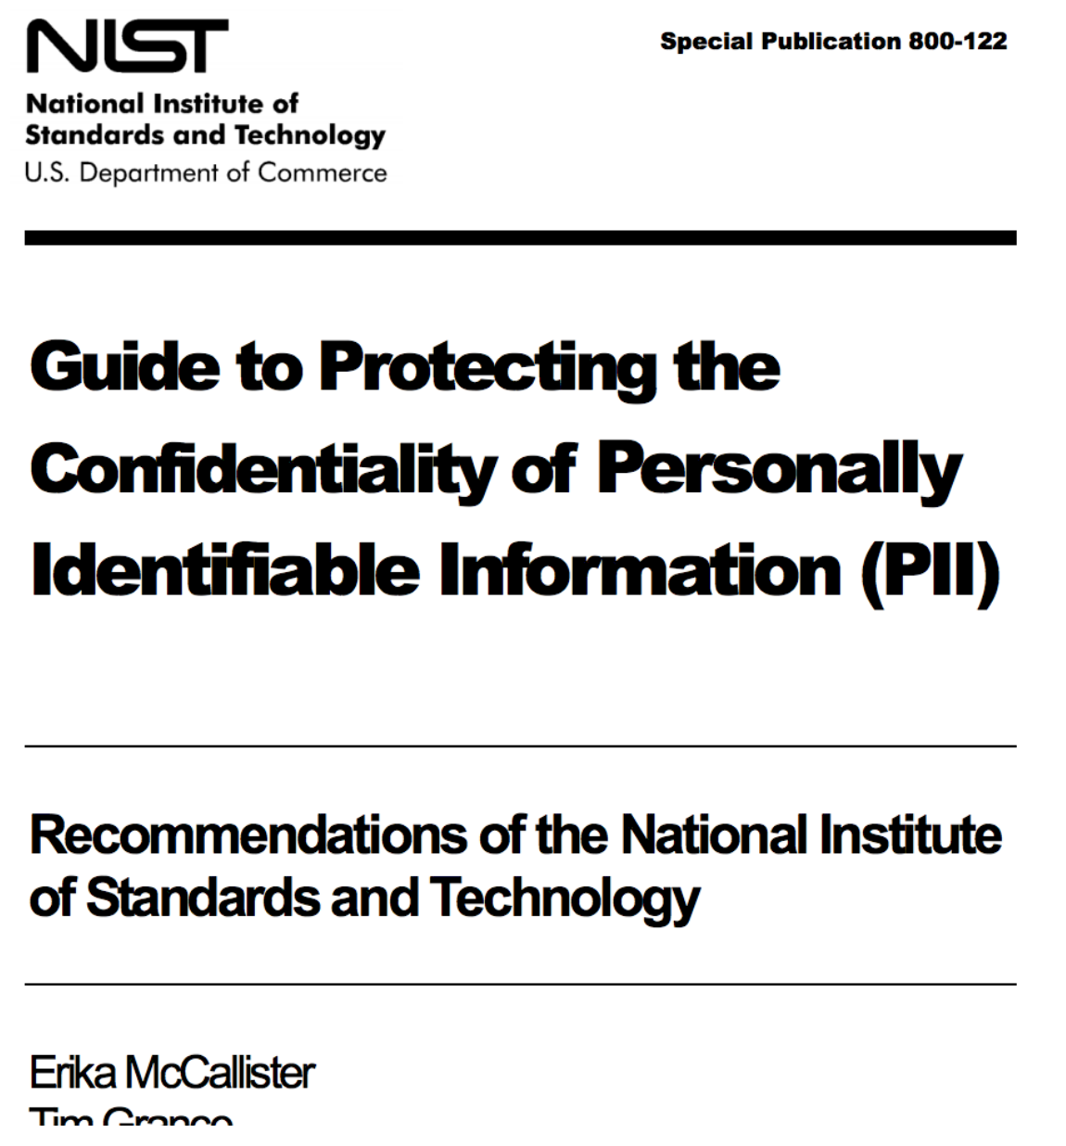
How do you share sensitive data?
What about Anonymity?
Anonymity enables:
Data sharing
for research
testing new analytics
Conform to existing regulation or guideline
various policy require hiding/deleting sensitive information
Is Privacy = Anonymity?

Slide 10
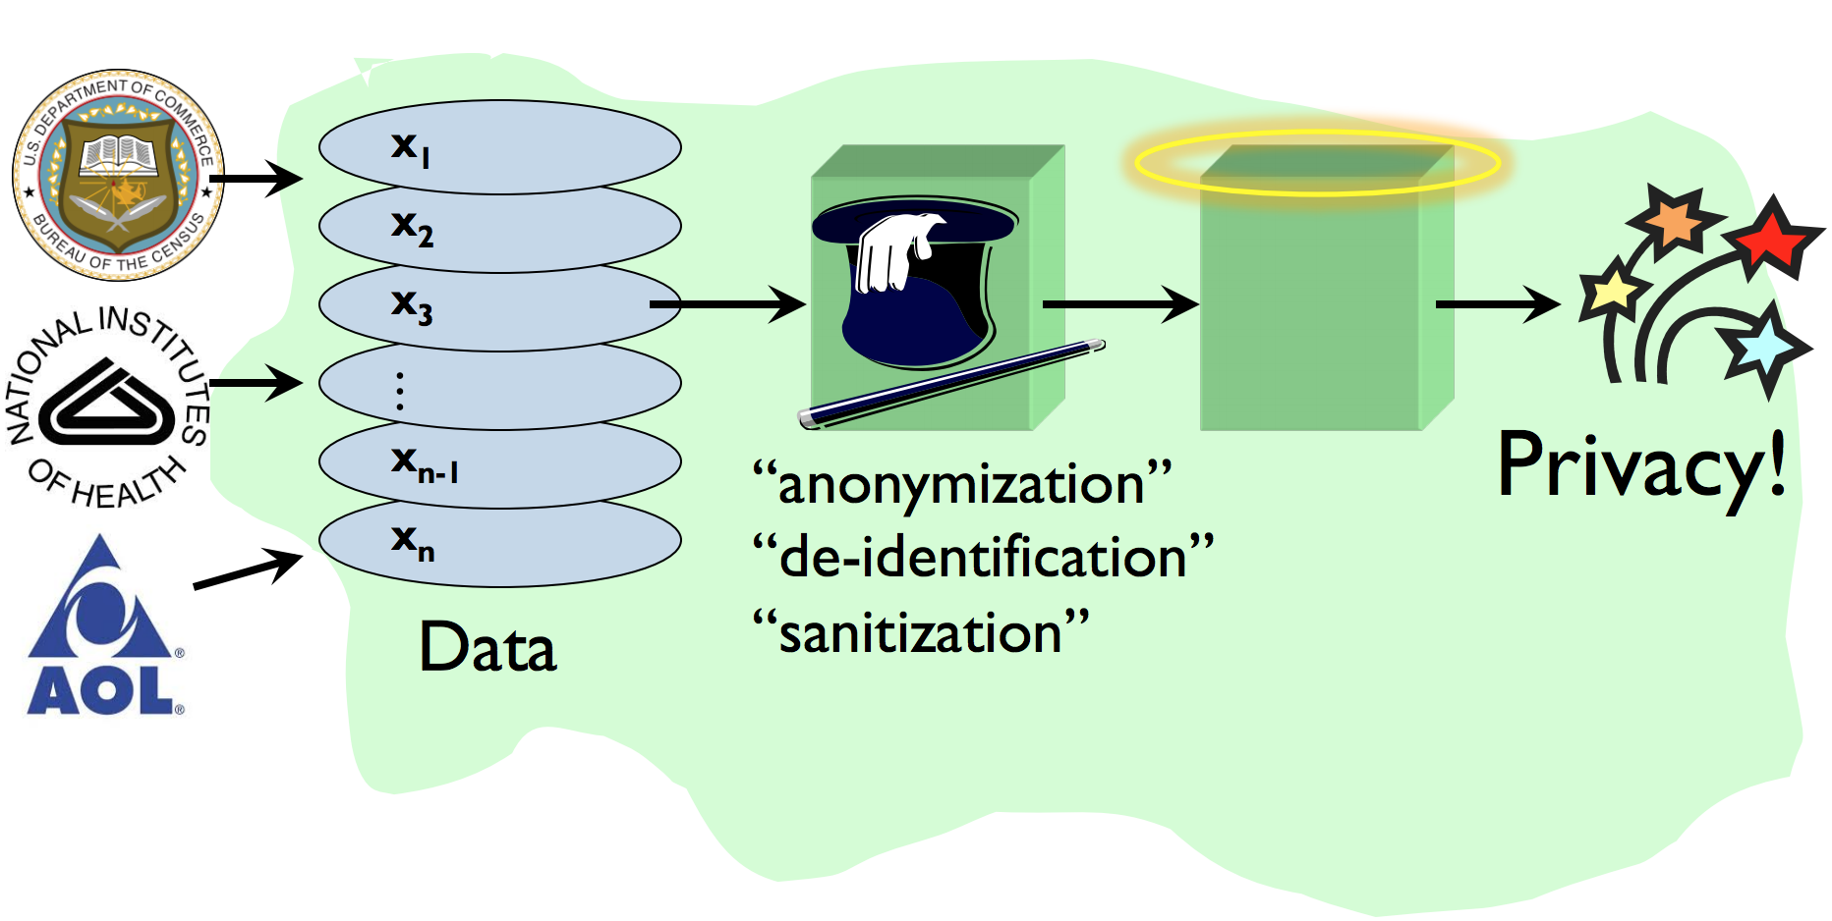
Privacy-preserving data release process

Slide 11
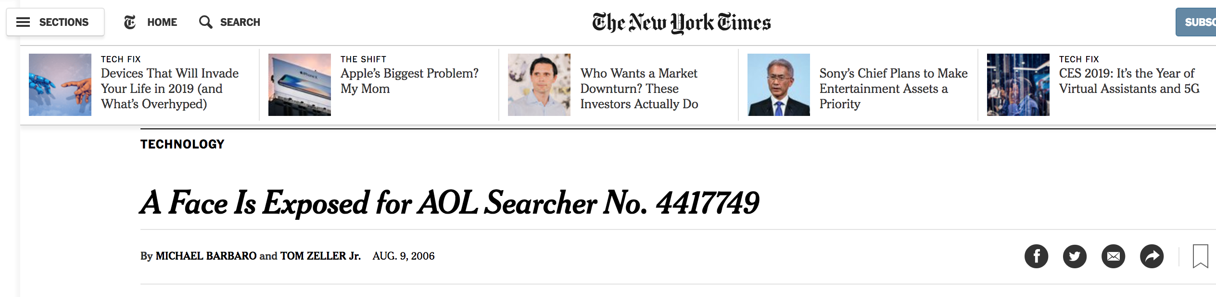
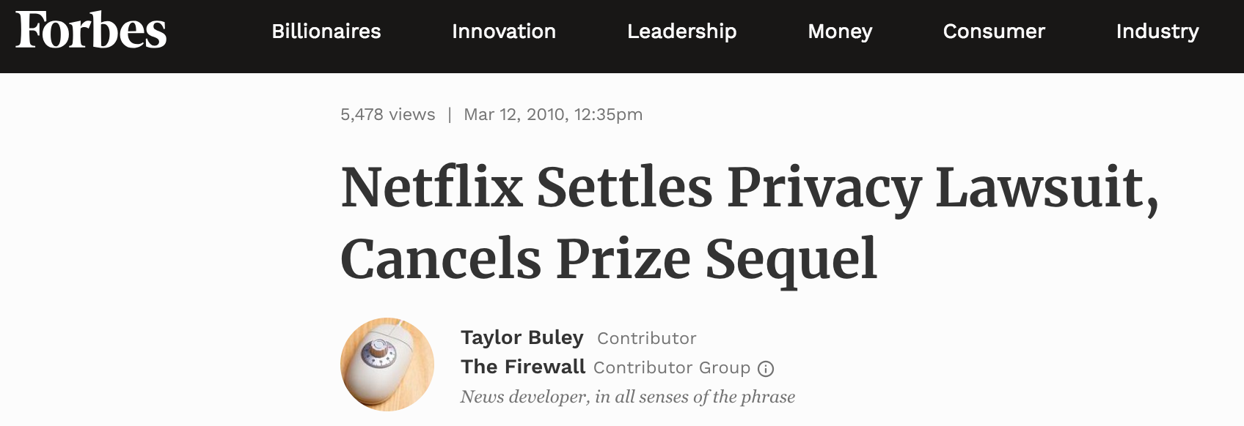
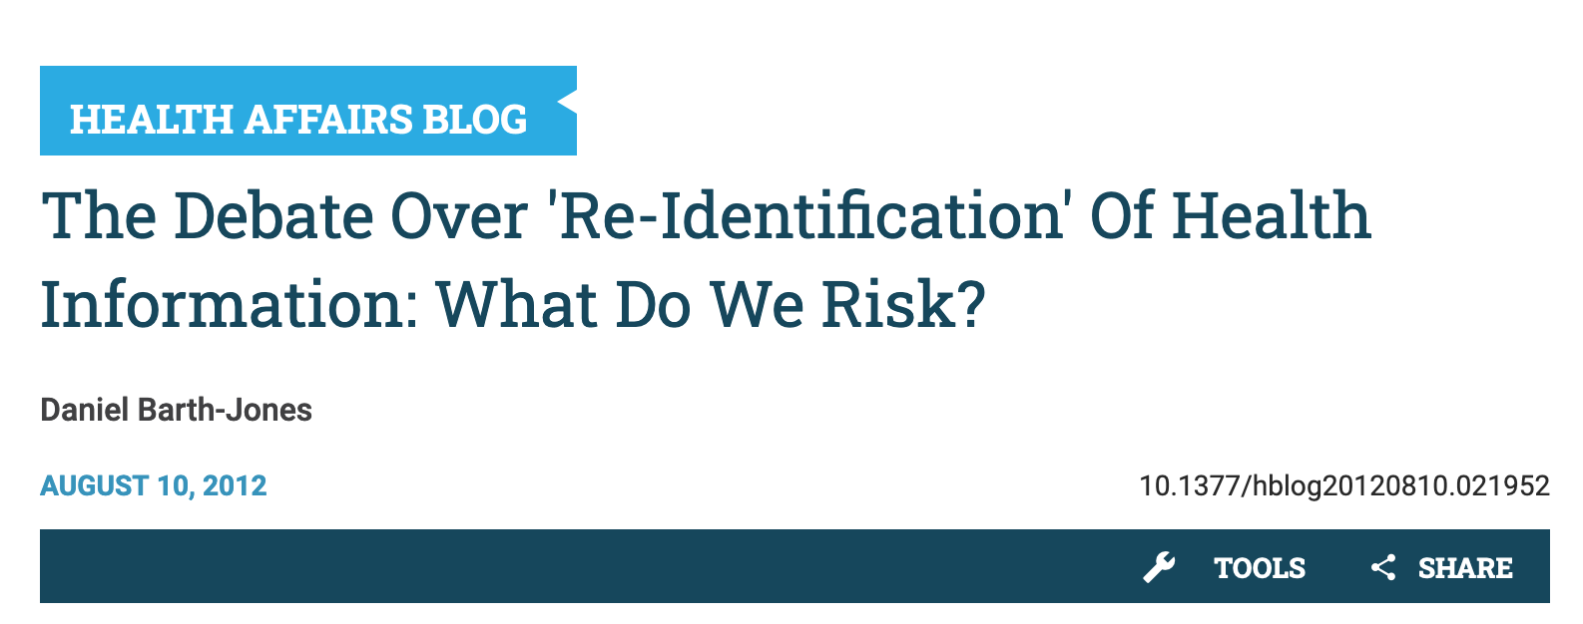
We still see privacy disasters!
What went wrong?

Slide 12
Case studies of undesired inferences
AOL search query data
The Massachusetts governor privacy breach
Census data
Netflix prize data
Social network deanonymization

Slide 13

Case 1: AOL search queries
Raw data: 20M search queries for 650K users from 2006
Why released: allow researchers to understand search patterns
How anonymized: user identifiers removed
All searches from same user linked by an arbitrary identifier
Attacks: many successful attacks identified individual users
NY Times identified 4417749 as 62yr old GA widow [Barbaro Zeller 06]
Consequences: CTO resigned, two researchers fired
Well-intentioned effort failed due to inadequate anonymization

Slide 14

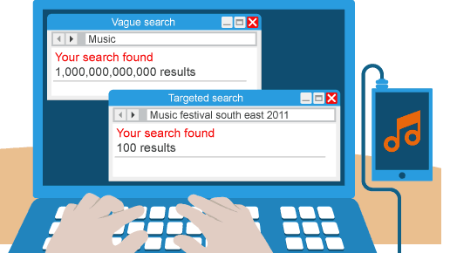
Search queries tell a lot
You have a coffee maker
You drink coffee regularly
Atlanta
You like music
You live in the south east of Atlanta

Slide 15
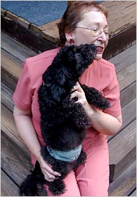
AOL userID 4417749
AOL query logs have the form
<AnonymousID, Query, QueryTime, ItemRank, ClickURL>
User 4417749 queried: “numb fingers”, “60 single men”, “dog that urinates on everything”, “landscapers in Lilburn, Ga”, “people names with last name Arnold”, “homes sold in shadow lake subdivision gwinnett county georgia”
Only 14 citizens with the last name Arnold near Lilburn, GA
NYT contacted the 14 citizens, found out AOL User 4417749 is 62-year-old Thelma Arnold

Slide 16
Case 2: The Massachusetts privacy breach
Released datasets can be used for linking anonymized datasets with other existing datasets
Example: Massachusetts Group Insurance Commission Incident
Massachusetts GIC released “anonymized” data on state employees’ hospital visit
Then Governor William Weld assured public on privacy
Name | SSN | DoB | Gender | ZIP | Diagnosis
Alice | 123456789 | 01/23/1964 | F | 15678 | Diabetes
Bob | 623452189 | 02/03/1964 | M | 15609 | Asthma
Eve | 873456721 | 09/13/1965 | F | 31892 | Diabetes
John | 227656752 | 12/30/1967 | M | 31402 | Cancer
Tom | 827356780 | 06/09/1961 | M | 31609 | Diabetes
Amy | 723421709 | 08/21/1969 | F | 23194 | Asthma

Slide 17
Linkage attack
DoB | Gender | ZIP | Diagnosis
01/23/1964 | F | 15678 | Diabetes
02/03/1964 | M | 15609 | Asthma
09/13/1965 | F | 31892 | Diabetes
12/30/1967 | M | 31402 | Cancer
06/09/1961 | M | 31609 | Diabetes
08/21/1969 | F | 23194 | Asthma
Name | DoB | Gender | ZIP | Political Affiliation
Alice | 01/23/1964 | F | 15678 | Democratic
Alex | 06/17/1974 | M | 15609 | Republican
Ben | 11/13/1969 | F | 31892 | Democratic
Ema | 04/26/1971 | M | 54402 | Democratic
Rose | 05/15/1981 | M | 67709 | Republican
Kevin | 07/09/1989 | F | 12394 | Republican
Medical Data
Voter registration data
Latanya Sweeney* linked the medical data with Voter roller in Cambridge and identified Governor Weld’s record !
*Latanya Arvette Sweeney is a Professor of Government and Technology in Residence at Harvard University

Slide 18
Attribute classification
K₁, K₂,..., K_{m} - Key attributes
E.g., name, address, phone number, SSN
uniquely identifying!
Always remove before release
Q₁, Q₂,..., Q_{m} - Quasi-identifiers
individually not unique but when grouped they are
(5-digit ZIP code, birth date, gender)
S₁, S₂,..., S_{m} – Sensitive attributes
E.g., medical condition, salary, etc.
These attributes are often used for analytics

Slide 19
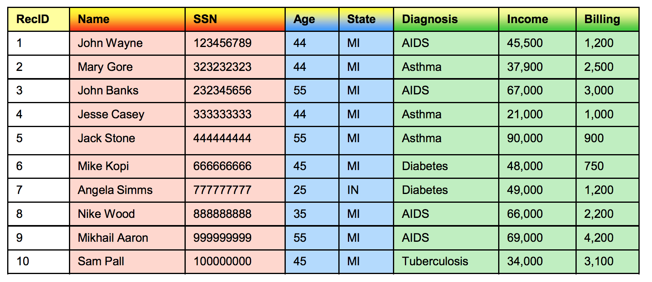
Identifiers vs. Sensitive Attributes
Key attributes
Quasi identifier
Sensitive attributes

Slide 20
Exercise: Sensitive combinations
Table with three columns:
Physician
Patient
Medication
Which combinations are sensitive?
R(Physician, Patient): Sensitive?
R(Physician, Medication): Sensitive?
R(Patient, Medication): Sensitive?

Slide 21

How unique is the US demographic?
Latanya Sweeney showed using 1990 census data -
18% (45M of 248M) of the population were uniquely identifiable based on <DoB, County, Gender>
53% (132M of 248M) of the population were uniquely identifiable based on <DoB, Gender, Place>
87% (216M of the 248M) of the population were uniquely identifiable based on <DoB, Gender, 5-digit ZIP>
Source: L. Sweeney, Uniqueness of Simple Demographics in the U.S. Population, LIDAPWP4. Carnegie Mellon University, Laboratory for International Data Privacy, Pittsburgh, PA, 2000

Slide 22
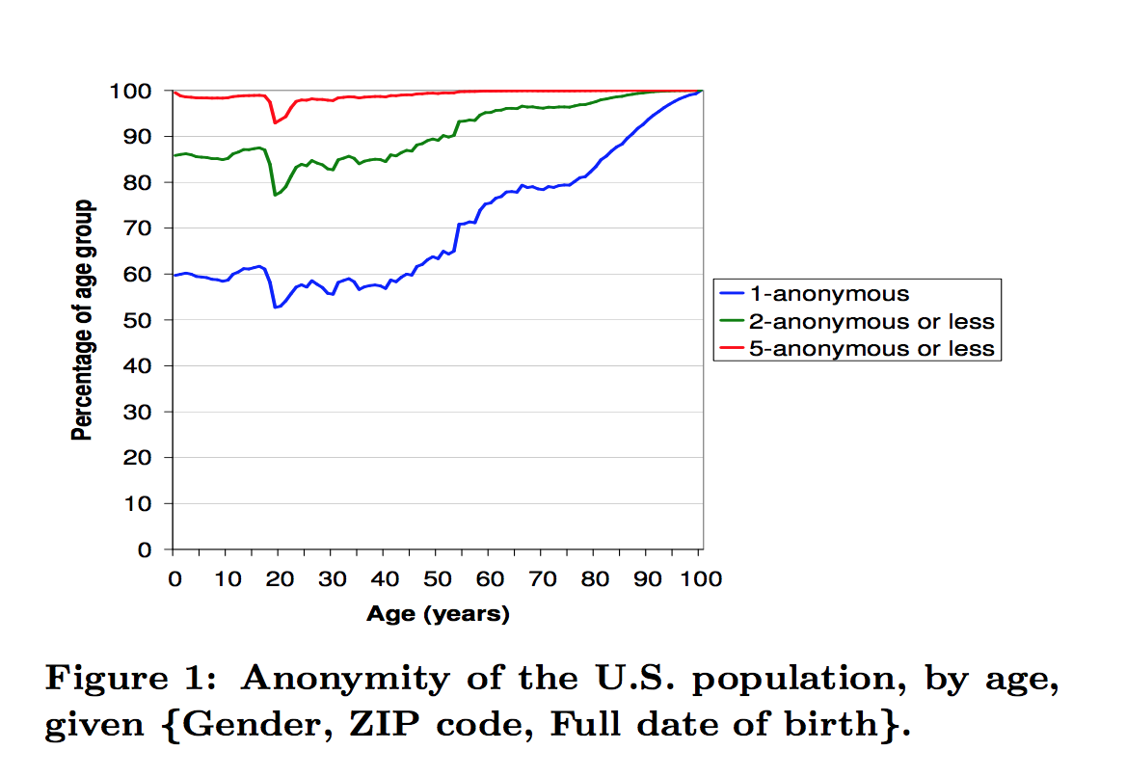
More recent study
higher aged population more easily identifiable
Philippe Golle, Revisiting the uniqueness of simple demographics in the US population
Census 2000 dataset
63% of the population were uniquely identifiable based on <DoB, Gender, 5-digit ZIP>

Slide 23

Case 3: Netflix Prize data
Raw data: 100M dated ratings from 500K users for 18K movies
Why released: improve predicting ratings of unlabeled examples
How anonymized: exact details not described by Netflix
All direct customer information removed
Only subset of full data; dates modified; some ratings deleted,
Movie title and year published in full
Attacks: dataset is claimed vulnerable [Narayanan Shmatikov 08]
Attack links data to IMDB where same users also rated movies
Find matches based on similar ratings or dates in both
Consequences: rich source of user data for researchers
Netflix stopped prize sequel
De-anonymizing Social NetworksArvind Narayanan and Vitaly Shmatikov, IEEE SP 2008

Slide 24
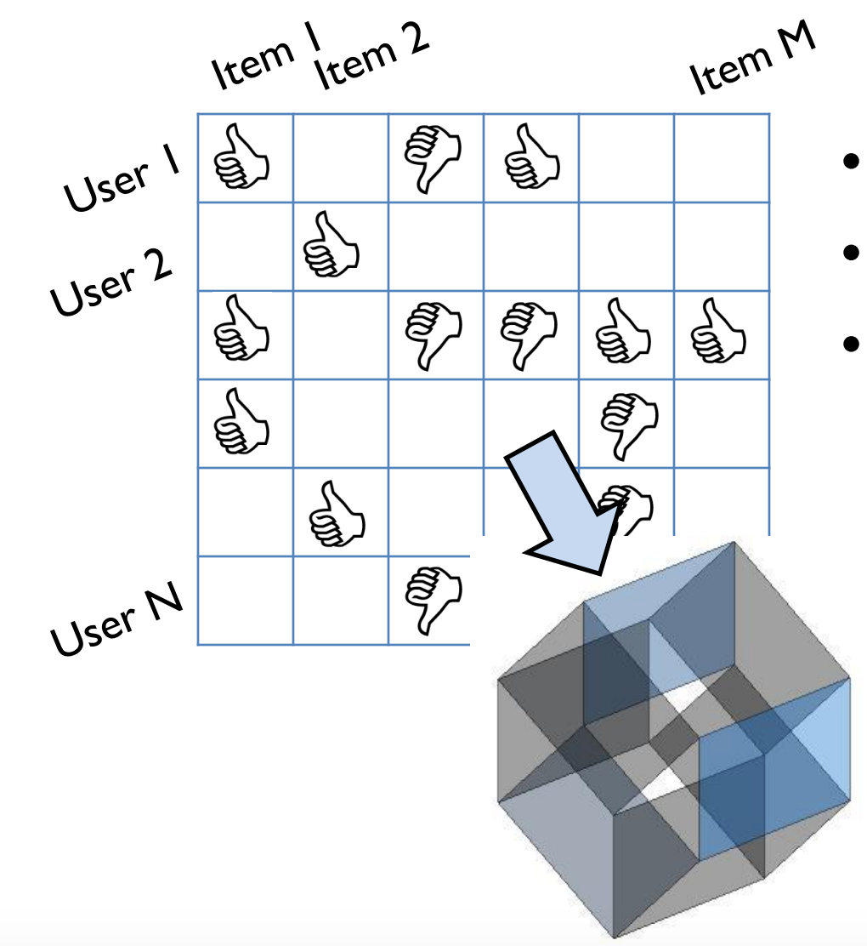
Netflix dataset characteristics
Row = a user
Column= rating of a movie and time
<[1-5], date>
Thousands of dimensions
~18K movies
Sparse datasets
few users share similar movies

Slide 25
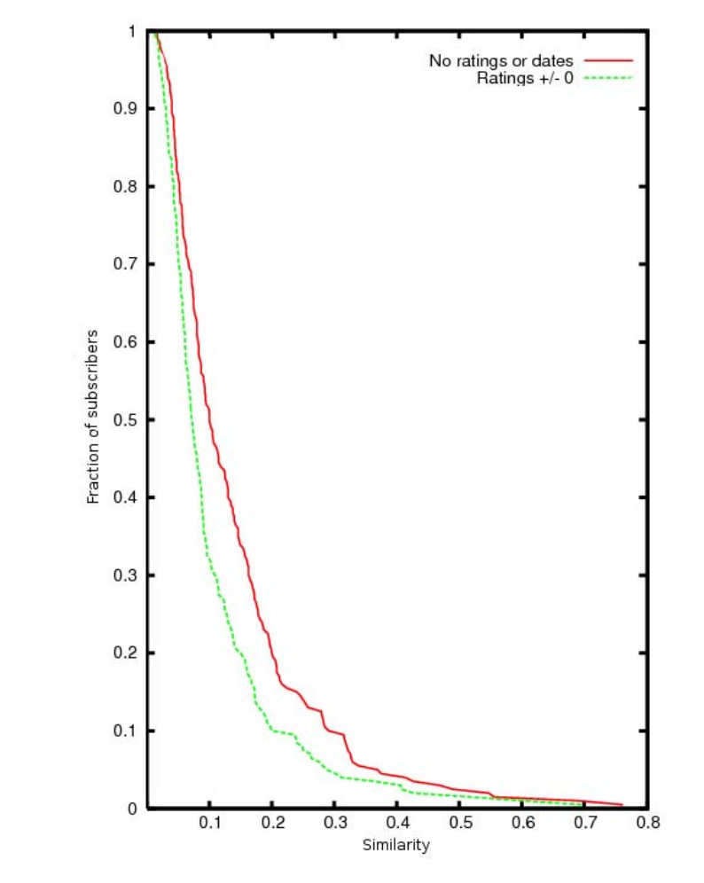
Verifying sparsity of the dataset
Compare ratings of two individuals
Average records has no “similar” records
Netflix Prize dataset:
Considering just movie names, for 90% of records there isn’t a single other record which is more than 30% similar

Slide 26
Sparse dataset: No quasi-identifiers
As the dataset is sparse --no consistent identifiers across all rows
Should be good for privacy?
But auxiliary information may help narrow down!
Not unique tuple across all rows

Slide 27
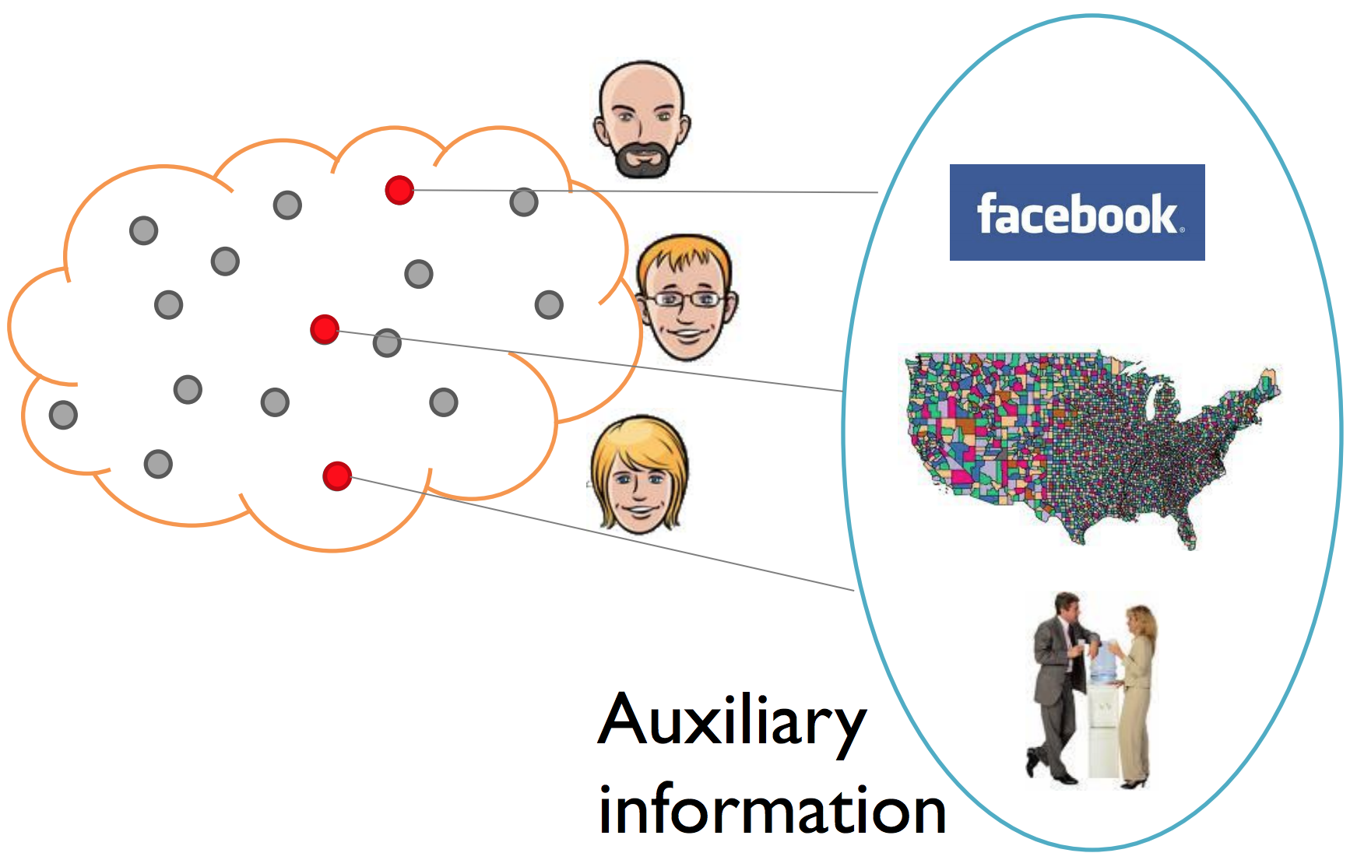
De-anonymizing sparse data
Various data sources nowadays
Personal knowledge/communication
Your Facebook page!!
Public datasets
(Online) white pages
Scraping webpages
Stealthy
Web trackers, history sniffing
Phishing attacks or social engineering attacks in general

Slide 28
De-anonymization Objectives
Fix some target record ‘r’ in the released dataset
Goal: learn as much about ‘r’ as possible
Refine “de-anonymization” goal using auxiliary data
Find a user (or group of users) in the auxiliary data who is very similar to the target
OR
Determine the target is not in the released database

Slide 29
De-anonymization Challenges
Auxiliary information is noisy
Can’t use standard information retrieval techniques
Released records may be perturbed
Only a sample of records has been released
False matches
No oracle to confirm success!

Slide 30
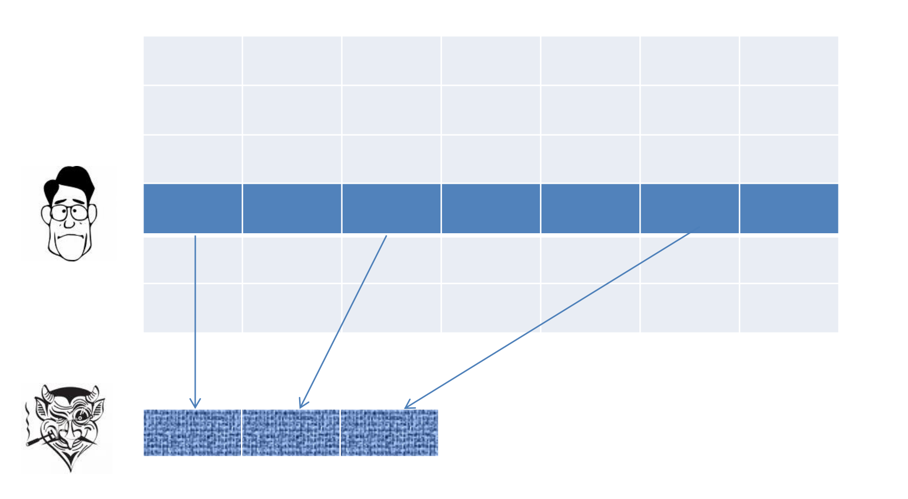
Aux as Noisy Projection
Only a handful of the attributes may be present in the auxiliary dataset
(i.e., the same set of movies may not be rated in both datasets)

Slide 31
General strategy
Inputs: Private database D, and auxiliary information AUX (e.g., IMDB)
Pairwise Matching: Compute the similarity between candidate matching pairs
Based on attributes of the individuals
Record Linkage: For each record in AUX, find the best matching record in D (or no match) … or vice versa

Slide 32
Similarity metric
Given records r in D and r_{aux} in AUX
For each movie m,
Sim(r[m], r_{aux}[m]) = 1 if m was rated in both records with similar
values and at similar times
= 0 otherwise
Sim(r[m], r_{aux}[m]) could be a more evolved metric like normalized rating

Slide 33
Pairwise matching
Given a vector of component-wise rating for a pair of records (x,y), compute Score(x, y).
Solutions: Weighted sum or avg. of component-wise similarity scores
w₁*Sim[m₁]+ w₂*Sim[m₂] + w₃*Sim[m₃] + ...
How to pick weights?
Similarity on a rare attribute (rate movie) is more predictive of match than similarity on common attribute (blockbuster)
w_{i} = 1/frequency(m_{i})
Threshold determines potential candidates

Slide 34
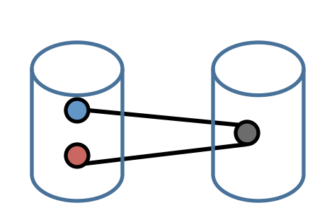
What if multiple candidates match?
AUX
D
Threshold might return multiple
potential candidate
Pairwise matching may result in 2 records in AUX having similar score to the same record in D
How can we be sure of the match between AUX and D?
Solutions: Pick the best match if the second best match has a very low score … else no match (NETFLIX ATTACK SOLUTION)

Slide 35
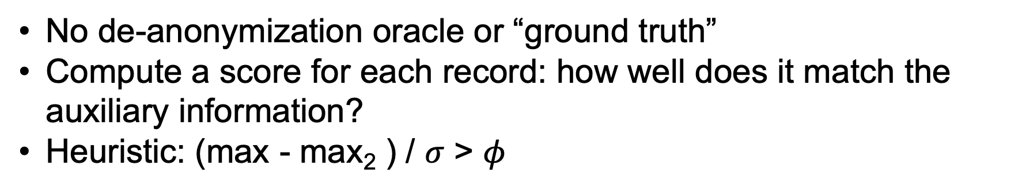
Self-testing
Methodological question: how does the attacker know the matches aren’t spurious?
No de-anonymization oracle or “ground truth”
Compute a score for each record: how well does it match the auxiliary information?
Heuristic: (max - max₂ ) / $σ$ > $φ$
Best score
2nd Best score
Eccentricity
D
AUX

Slide 36
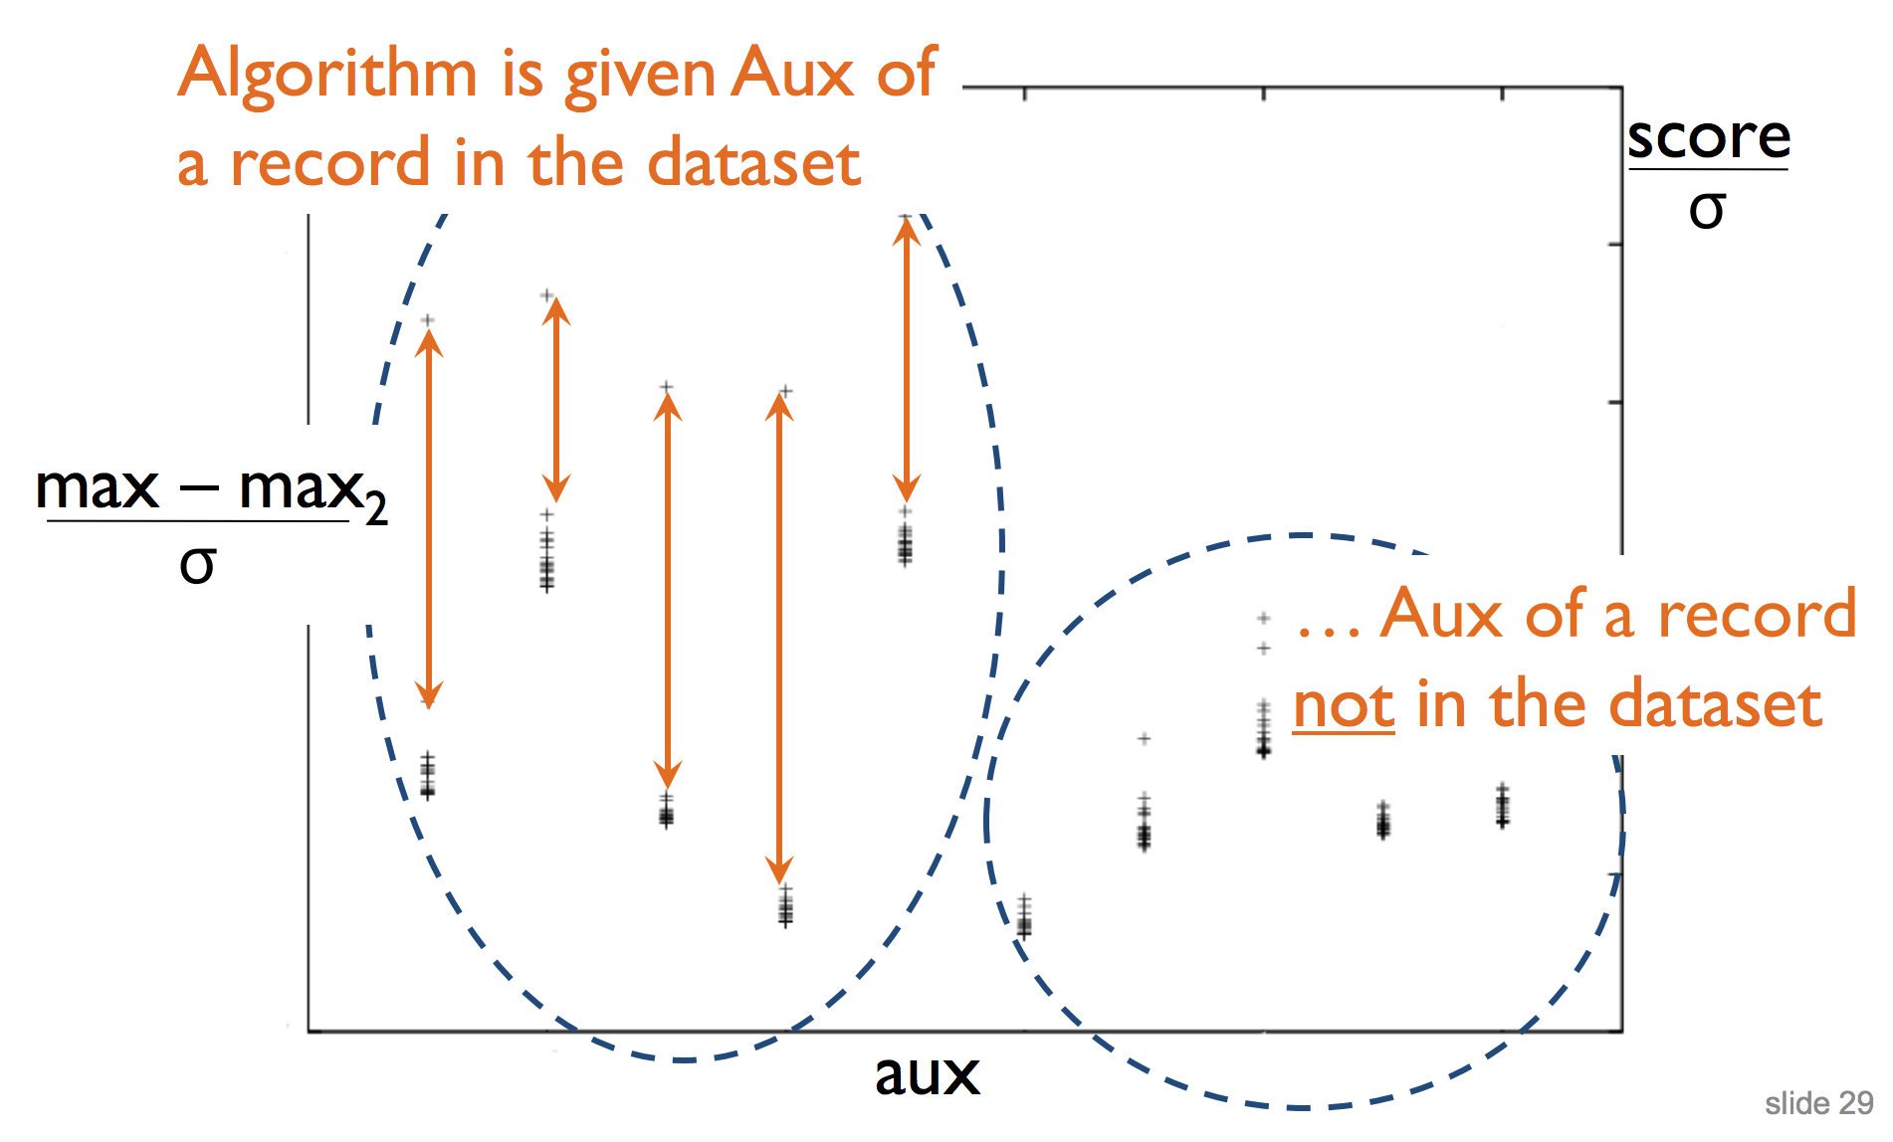
Eccentricity in the Netflix Dataset
A match holds iff the two highest values differ by more than1.5 times the standard deviation of the scores

Slide 37
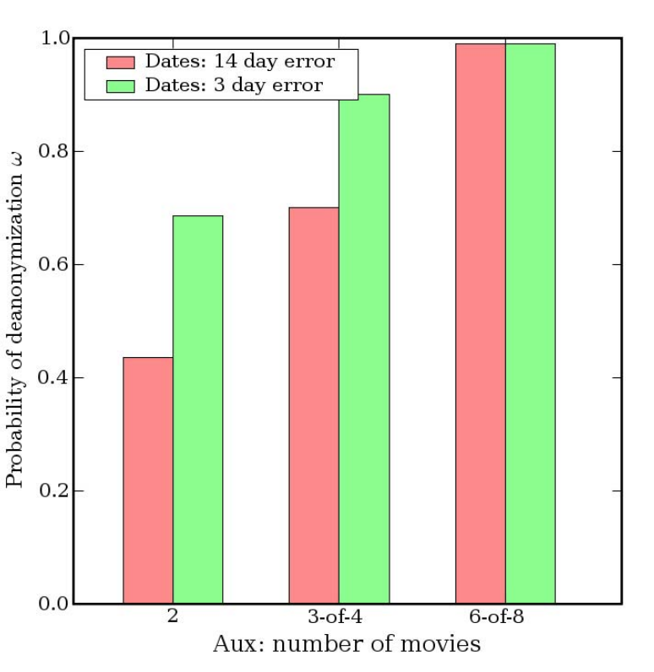
De-anonymization: Experimental Results
With 8 movie ratings (of which 2 may be completely wrong) and dates that may have a 14-day error, 99% of records can be uniquely identified in the dataset.
For 68%, two ratings and dates (with a 3-day error) are sufficient

Slide 38
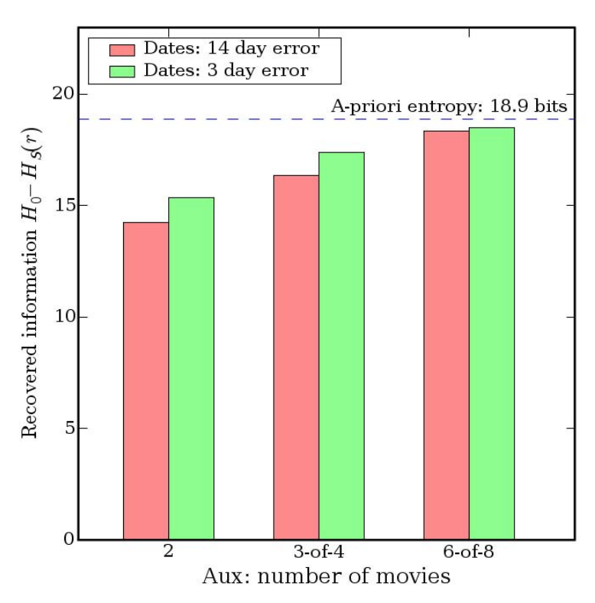
Robustness
For full de-anonymization less than a bit of more auxiliary information is required.
500K users -> 18.9 bits of entropy
Algorithm is robust to errors
Dates and ratings may be known imprecisely, some may be completely wrong
Perturbation = noise in the data => doesn’t matter!
Nearest neighbor is so far, can tolerate huge amount of noise and perturbation

Slide 39
Self-testing: Experimental Results
After algorithm finds a match, remove that record and re-run
With very high probability, the algorithm now declares that there is no match

Slide 40
Case 4: Social network deanonymization
Social networks A and B have overlapping memberships
Owner of A releases anonymized, sanitized graph
say, to enable targeted advertising
Research - academic and government data-mining
Can owner of B learn sensitive information from released graph A’?

Slide 41
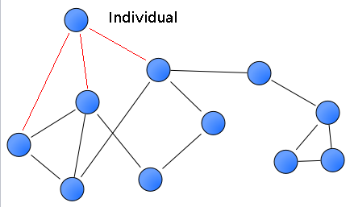
What is social graph?
Social network graph consists of nodes (individuals), edges (relations) and information associated with each node and edge.
Attributes attached to nodes are very sensitive.
Credit card number, SSN
Note: The existence of an edge between two nodes can also be very sensitive.
Had a romantic relationship
Name

Slide 42


Releasing social graph
Select subset of nodes and subsets
of node and edge attributes to be released
Compute the induced subgraph on V_{san}
Remove some edges and add fake edges (perturbation)
Summary: a sanitized subset of nodes and edges with the corresponding attributes.

Slide 43
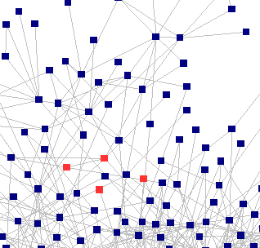
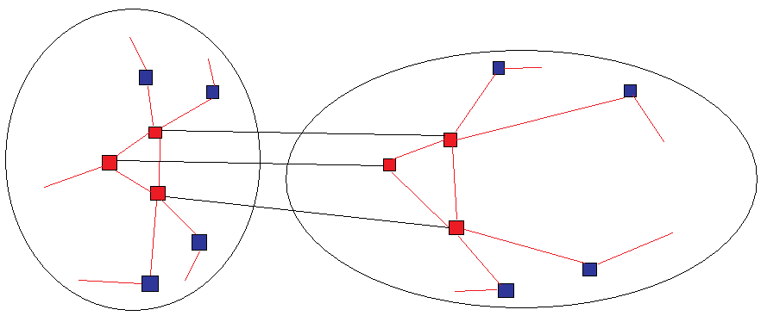
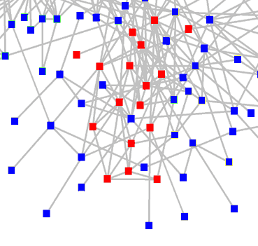
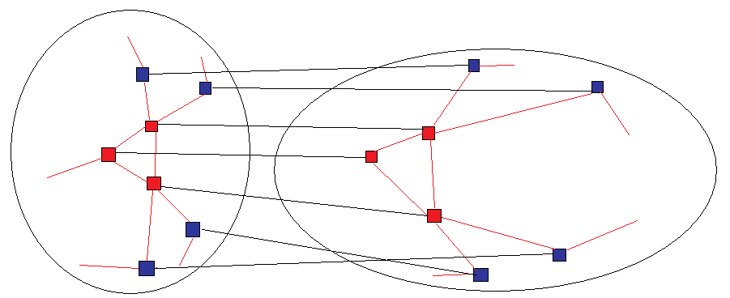
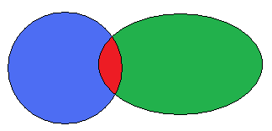
Other social graphs are out there
Flickr
Twitter
1. Seed identification
2. Propagation
auxiliary information from overlap

Slide 44
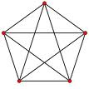
Seed Identification
Input:
A clique of k nodes (likely to be known to be common to both graphs).
Degree of each of these nodes (in AUXILIARY)
Number of common neighbors for each pair of nodes (in AUXILIARY)
AUXILIARY
TARGET
Algorithm:
Search for a unique k-clique (on TARGET) that has:
matching degrees (with some error factor)
common neighbor counts
Outputs µ_{s}, a partial mapping.
Notes:
Complexity(2): Terminating the algorithm as soon as more than one match is found greatly decreases the running time.

Slide 45
Propagation
G1
G2
Propagation stage is a self-reinforcing process.
Input:
G1(V1, E1)
G2(V2, E2)
A “seed” mapping between the two.
Output: New Mappings between nodes in G1 and G2 besides seed mappings.
B
Y
U
A
Z
X
C
E
D
W
Initial: Mapping list={(B,Y), (C, Z),(D, W)}
Iteratively compare all pairs: Score(A, X) = 2, Score(A, U) = 0
Update mapping list = ={(B,Y), (C, Z),(D, W), (A,X)}
Score: number of matching mapped neighbors

Slide 46


Real-world OSN test
Type | Network | Relation. | Nodes | Edges | Av. Deg | Crawled
Target | Twitter | Follow | 224K | 8.5M | 27.7 | 2007
Auxiliary | Flickr | Contact | 3.3M | 53M | 32.2 | 2007/8
In both API exposes:
Mandatory username
Optional name
Optional location
De-anonymizing Social Networks. Arvind Narayanan and Vitaly Shmatikov, IEEE SP 2009

Slide 47
Experiment Results
30.8% of the mappings were re-identified correctly.
57% were not identified
12.1% were identified incorrectly
41% of them were mapped to distance 1 nodes from the true mapping
55% of them were mapped to nodes with the same geographic location
27% are completely erroneous

Slide 48
Lessons
Anonymized dataset can leak sensitive information:
even if key identifiers are removed inference might still be possible
high dimensional data is likely unique
meta data may leak sensitive information
attacker’s background knowledge is important in formally defining privacy notions

Slide 49
Logistics
Course projects: groups of two to three students. The scope of the project will scale with the size of the group. You are encouraged to form your own groups
You are encouraged to suggest your own topic. Submit ideas through Moodle (submit 2-3 ideas).
Deadline | Task
08/20 | Project selection due
08/21 | Project assigned to team group
08/28 | Project proposal, 1-3 pages (10 points)
10/06 | Project progress report, 4-8 pages (30 points)
11/16 | Final report, 8-10 pages (60 points)
https://anupamdas.org/teaching/csc-533-fa2020/projects.html

Slide 50
Logistics
Signup for:
Piazza (class discussion):
https://piazza.com/ncsu/fall2020/csc533
Moodle (lectures, videos, assignments, announcements):
https://moodle-courses2021.wolfware.ncsu.edu/course/view.php?id=2630
Office hours:
Campus students, Th 2-3pm.
https://ncsu.zoom.us/j/95186207307?pwd=YUdmMHJ0TkErcElzVytxampoaUlsdz09
DE students, Tu 8-9pm (NY time),
https://ncsu.zoom.us/j/91919947226?pwd=UmNNZjNVU093ajNFZEJYcnhrVXBDdz09
TA: Shaohu Zhang (szhang42@ncsu.edu)
M/W: 2-3pm
https://ncsu.zoom.us/j/98902722937?pwd=NTdGVHphTzJ2VTZPMERLaGtScVNSUT09

